Slide 1

Predicting Used Car Prices
Project 2 - Luther
Ferdinand Wohlenberg
July 19, 2019
New York, NY
Notes:
Hi everyone, I developed a Machine Learning Model in order to predict Used Car Prices

Slide 2





Introduction
Quick Facts
Used car sales dominate the car market (75% of U.S. market)
Average car has 3 owners over its lifetime
Objective
Exploit relationship between car features and its price
Finding most influential factors
Notes:
Let‘s start with some quick facts.
- Used car sales dominate the auto market with 75% of total car sales in the US being used cars
- Average car has 3 owners over ist lifetime
Objective:
Exploiting relationship bweteen car feature and its price
Finding most influential factors

Slide 3
Methodology
Scraping
Data Wrangling
Modelling
Results
Source: cars.com
> 60,000 car entries
Sample from 44 states across the U.S.
18 features
Tool: BeautifulSoup
Cleaning
Aggregation
Tools: Pandas, Numpy
Approach:
Feature Engineering
Validation
Cross Validation
Regularization (Lasso)
Tools:
Sklearn, seaborn
Most influential factors
Model accuracy
Notes:
- Started by scraping data using cars.com
-Resulted in over 60,000 car entries from 44 states across the U.S.
18 features were scraped in total using Beautiful Soup
Before starting with the Modelling process, I had to engage in Data Wrangling: Cleaning the data from duplicates, falsified and inconsistent entries
Aggregate the entries into a few categories in order to find some common grounds among the different entries. To do that, I used Pandas and Numpy
Afterwards, I could start the Modelling process by beginning with Feature Engineering and later on using Validation and Cross Validation to find the best suited models. In the end, I made use of regularization in order to eliminate unnecessary features and make coefficients more comparable.
Finally, the model showed up the most influential factors and I‘ll show you the model accuracy

Slide 4
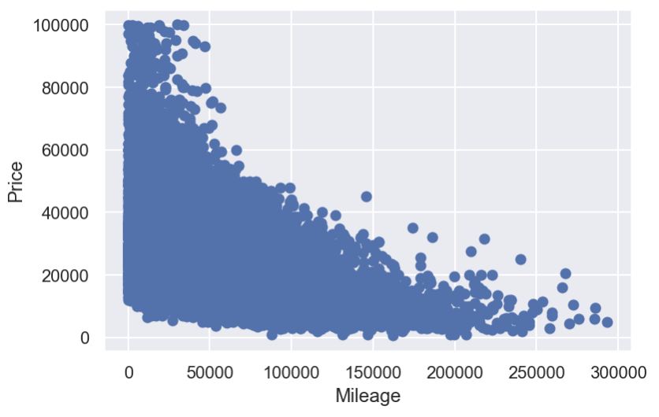
Feature Engineering - Baseline
R² - Score = 0.24
^{Features (Numerical):}
^{1.) Year}
^{2.) Seller Reviews}
^{3.) Seller Rating}
^{4.) Mileage}
Mileage vs. Price
Notes:
- Only numerical features as baseline which resulted in a R^2 score of 0.24.
- On the right, scatter plot of Mileage vs. Price, which has some kind of exponential relationship, but no real structure can be identified.
I plaeyd around with the numerical features and tried any combinations among then which only lfited the R^2 score slightly up to 0.26.
Significant difference arose when adding categorial festures

Slide 5
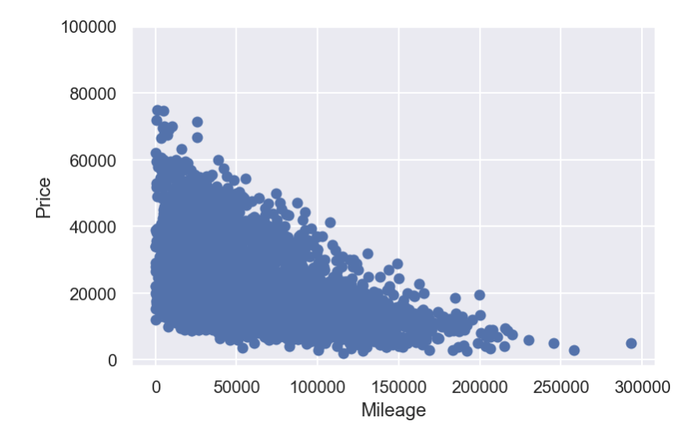
Feature Engineering - Carmaker
R² - Score = 0.47
Features (Numerical + Categorical):
^{1.) Year}
^{2.) Seller Reviews}
^{3.) Seller Rating}
^{4.) Mileage}
^{5.) Car Manufacturer}
Mileage vs. Price
Car Manufacturer = Chevrolet
Notes:
When adding categorical features, such as car manufacture and creating dummy variables, the R^2 score increased significantly and a slightly clearer structure can be identified in the scatter plot

Slide 6
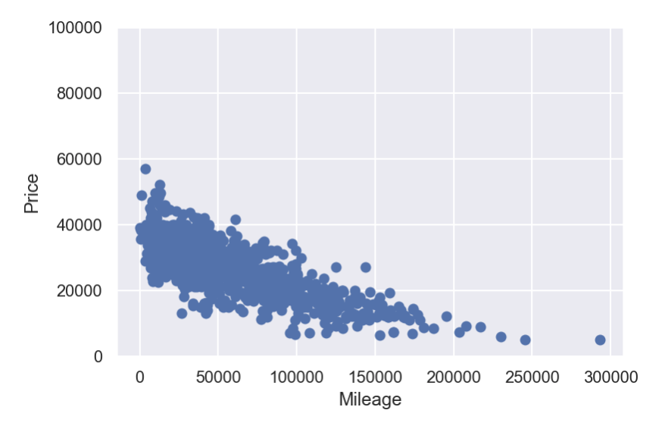
Feature Engineering - Model
R² - Score = 0.76
Features (Numerical + Categorical):
^{1.) Year}
^{2.) Seller Reviews}
^{3.) Seller Rating}
^{4.) Mileage}
^{5.) Car Manufacturer}
^{6.) Model}
Mileage vs. Price
Model = Silverado 1500
Notes:
After adding Model by creating dummy variables, the r^2 score increased again and now a clearer structure can be seen in the scatter plot

Slide 7



Results
Scoring / Accuracy
Final Model: Lasso Regression
R² – Score = 0.8
MAE = $3,180 (µ = $23k)
Most Impactful Coefficients
Positive:
Year (~ 6,500)
Mercedes- Benz (~ 2,600)
Mileage² (~ 2,200)
Negative:
Mileage (~ -4,900)
Year² (~ -3,100)
4 Cylinder Engine (~ -1,400)
Notes:
After adding all features, and trying Ridge, lasso, polynomial and linear, the Final model resulted being a Lasso regression with an R^2 score of 0.81
Looking at Most impactful Coefficients it can be observed that Year is the largest positive and second largest negative and Mileage the second positive and first negative. This kind of makes sense as the higher the year, the higher the price and the higher the mileage the lower the pirce. Since both the squared and linear term show up, this tells us that the variable is in between linear and quadratic which then equals out

Slide 8
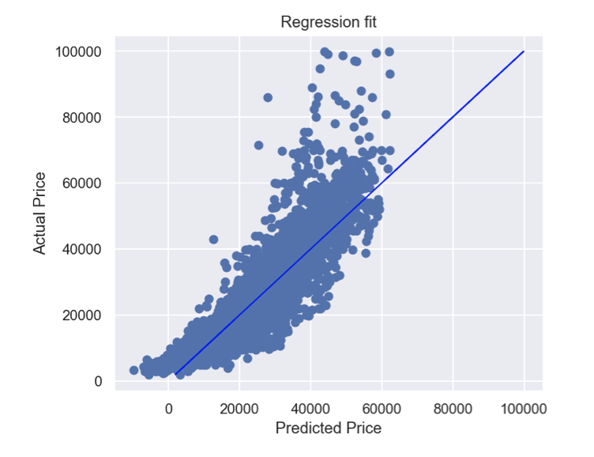
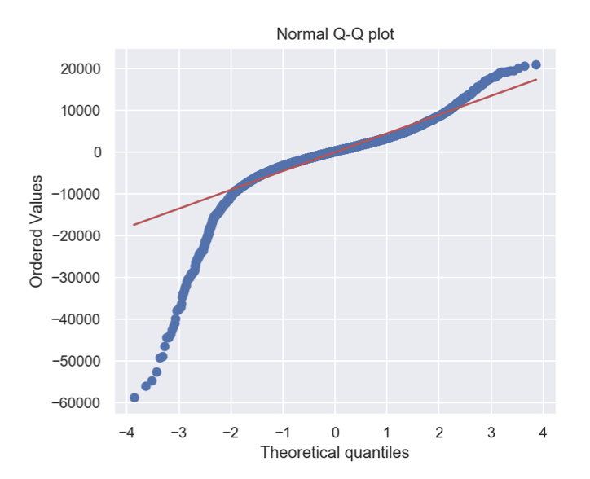
Results
Regression Fit
Q-Q Plot
Notes:
The graph on the left plots the predicted price vs. The actual price. And a normal Q-Q plot, which shows that the model is not normally disstributed
Overpredicted on low prices
- Heavily underpredicted on high prices

Slide 9
Results
Regression Fit
Q-Q Plot
Model = ‘‘Other“

Slide 10
Conclusion & Future Considerations
Model = Lasso regression (440 features)
Highest Coefficients: Year, Mileage, Carmaker, Engine, Transmission
Overpredicting low prices vs. underpredicting high prices
Possible Solutions:
Collecting further car model data
Finding more reliable sources
Adding more features
No. of doors
Body type (Coupe, Sedan, SUV)
Notes:
For the future to improve the model, further data could be collected in order to reduce the underpredicitos of high prices
Furthermore, more features could be added in order to increase the predictive power of the model

Slide 11
Conclusion & Future Considerations
Model = Lasso regression (440 features)
Highest Coefficients: Year, Mileage, Carmaker, Engine, Transmission
Overpredicting low prices vs. underpredicting high prices
Possible Solutions:
Collecting further car model data
Finding more reliable sources
Adding more features
No. of doors
Body type (Coupe, Sedan, SUV)
Notes:
For the future to improve the model, further data could be collected in order to reduce the underpredicitos of high prices
Furthermore, more features could be added in order to increase the predictive power of the model

Slide 12


Slide 13
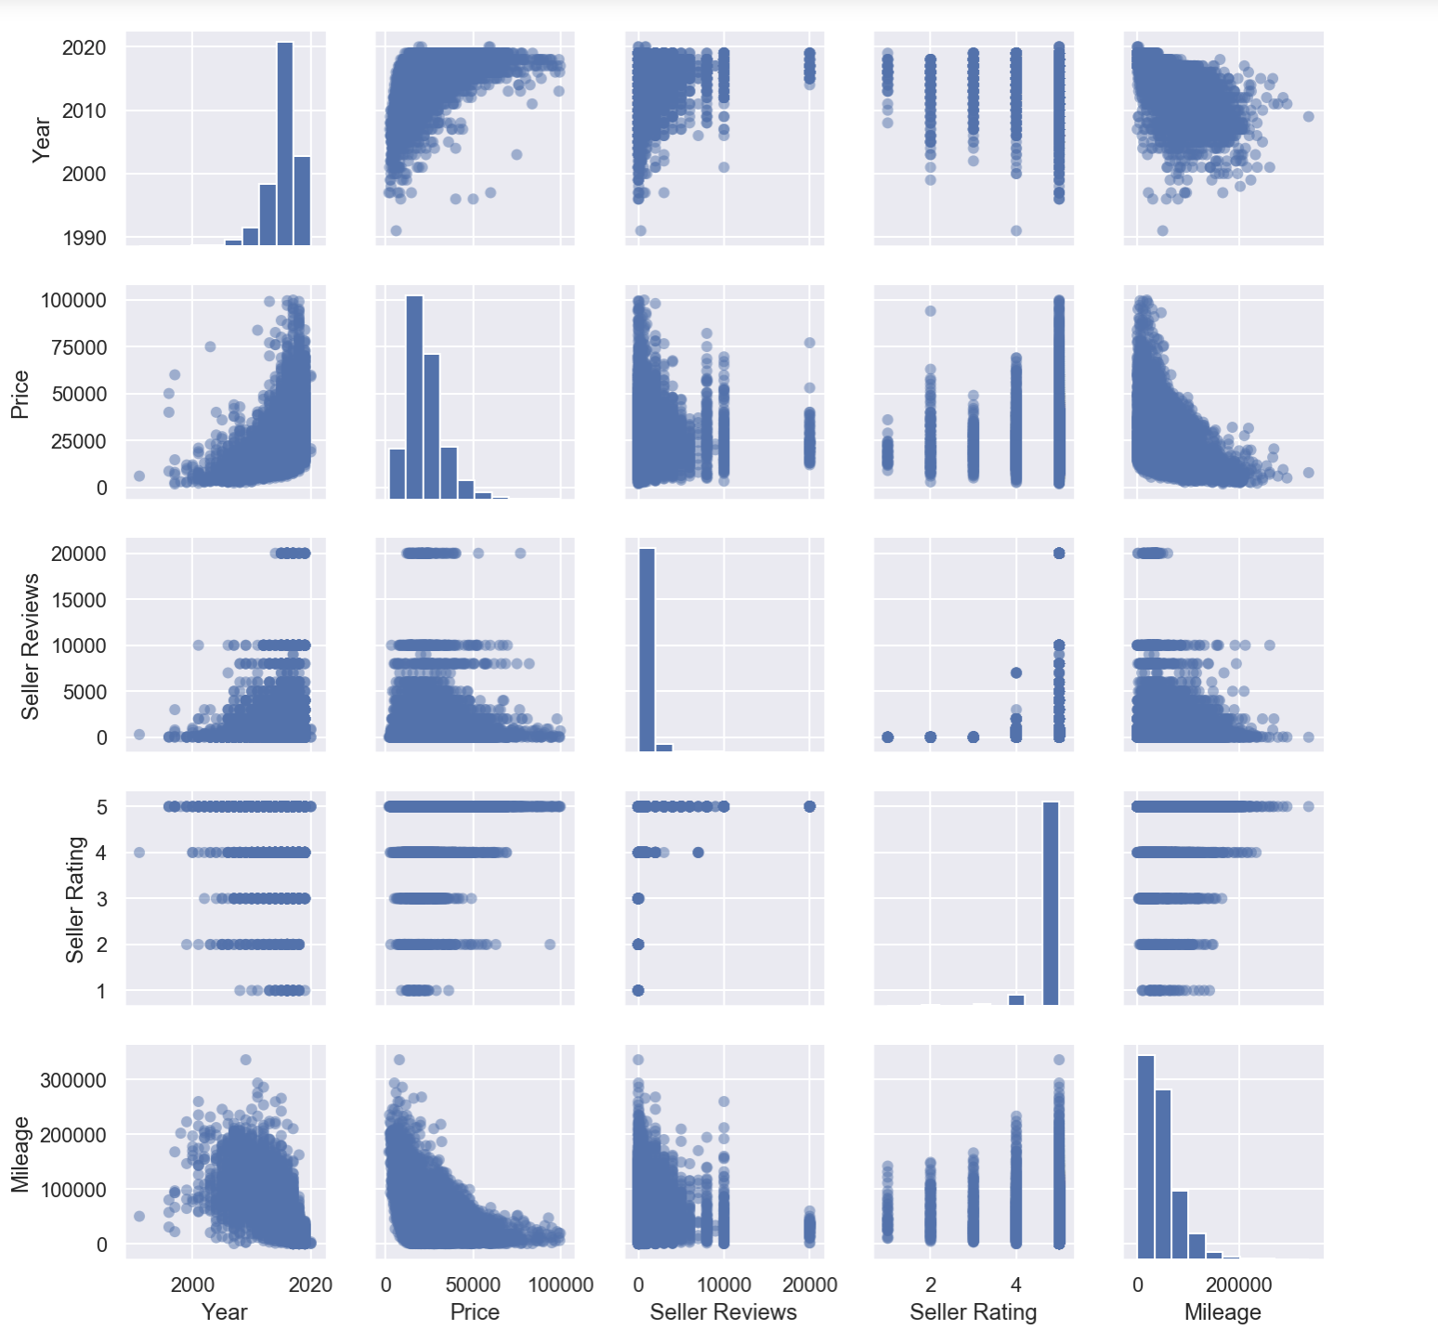
Appendix - Pairplot

Slide 14
Appendix - Modelling
Validation
Train / Test - 80:20
Train / Validation - 75:25
Regression Analysis Methods:
Linear -> Best score
Ridge
Polynomial
Cross Validation / Regularization
Train / Test - 80:20
K-Fold = 5
Regression Analysis Methods:
Linear
Ridge
Lasso -> Final Model
Notes:
After adding all categorical features and playing around with the numerical features, I used validation which resulted in Linear regression as the best model.
To verify the results and make the coefficients more comparable, I then applied cross validation and Regularization with Linear Regression, Ridge and Lasso, which was then chosen as best model

Slide 15
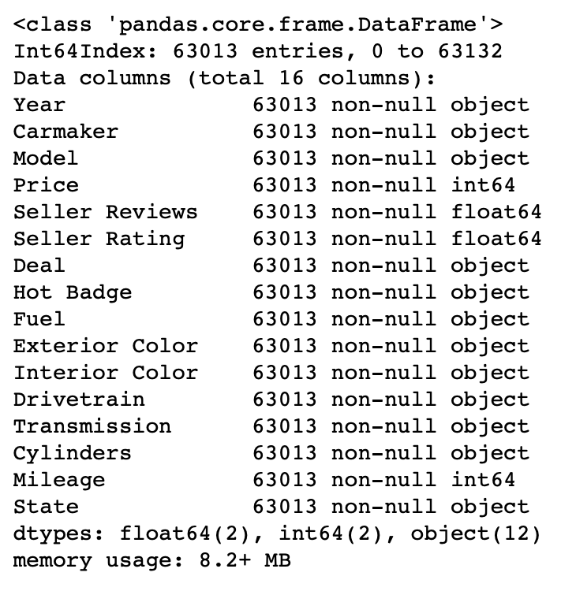
Appendix - Features

